Slide 1
Madhvesh Overseas GST 24FSQPD1838E1ZS www.madhveshoverseas.com
Manufacturer of Ferrous and Non Ferrous Alloys

Slide 2
Brief Introduction
Recently we have started a manufacturing facility ( Foundry ) to cater for petroleum products which will have a stronghold in manufacturing special / super alloys grades casting at high quality rate on customer’s requirement.
We also have expertise in Bi – Metallic and Tri – Metallic alloy pipes. Our current manufacturing set up caters for Pipes, Liners, Bushes, Tubes and Rotors etc.
At domestic from we supply to corporate company as well as merchant exporters too.

Slide 3
We believe in.. our conception
Believe in meeting customer's expectations making them delighted
Our employees have ownership mind helps in building the company.
We operate with honesty and integrity.
Continuously strive to improve and take on new challenges.
Commitment to safety.. commitment to timely delivering

Slide 4
Our competency
Manufacturing special / super alloys grade casting of high quality.
Fully mechanized & NDT testing operation customizable to meet clients requirements
Ferrous & Non ferrous castings in machined & hydro tested conditions for Defence,various Oil and Gas exploration,Refinery Industries.
Operate projects for material enhancement and altering or upgrading alloys required for application..tailor made solution for meeting customer needs..

Slide 5
Manufacturing Standards
We offer manufacturing as per ASTM, EN, DIN, IS, GOST, NACE standards:
Sn based
alloys
Co based
alloys
Cr based
alloys
Ni based
alloys
Cu based
alloys
Al based alloys
Fe based alloys

Slide 6
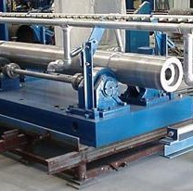
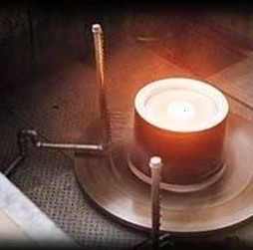
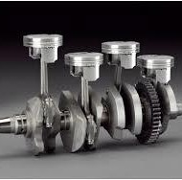
We make Fe, Cu, Al, Ni, Cr & Co base casting:
Centrifugal Casting Horizontal
Engineering & Automobile Parts
Centrifugal Casting Vertical
Brake Drums
Steel Rolls
Alloy Steel Tubes
Cylinder Liners
Pipe
Bearings
Non-Ferrous Castings
Ball Valve Balls
Electric Motor Rotors
Welding Rods
Gear Blanks
Gears
Flanges
Bearings
Bushings
Sheaves
Rolls
Engine Blocks, Pipes, Tubes, Liners, Bushing, Turbine rotors, Hydro turbine bushes, Worm gears, Basket bottom, Insulator Caps, Flanges, Gear Housing, Bearing cages

Slide 7
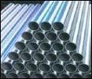
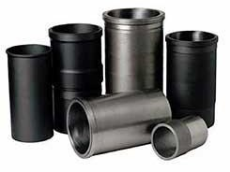
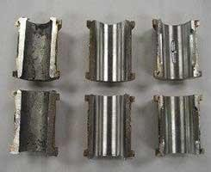
Manufacturing Processes
Sand Casting
₋ Shell Moulding
₋ CO2 Moulding
₋ Two part & Three Part system
Die Casting
₋ Horizontal Centrifugal casting
₋ Vertical Centrifugal casting
( bi-metallic)
₋ Gravity Die casting

Slide 8
We are equipped with:
Sr no. | Facility | Capacity
1 | Aluminium Melting furnace | 500 Kg
2 | Induction Furnance | 500 Kg
3 | Horizontal Centrifugal Machine | 2.5 Ton
4 | Bimetallic Horizontal Machine | 2.5 Ton
5 | Vertical Centrifugal Machine | 500 Kg
6 | Transfer Ladle | 500 Kg
7 | Sand Moulding Unit | 1 Ton
8 | Ladle preheating facility | _
9 | Mobile degassing unit | 350 -550 Kg
11 | Heat Treatment Furnaces | 1.5 ton
12 | Vaccum Impregnation Plant | 1M X 1M
13 | Pressure Testing facility | 1M X 1M
14 | Surface cleaning | 72"
15 | Fettling facility | _
16 | Spectro meter | 8 channels
17 | Metal Microscope | Software Based Analytical Sysytem
18 | Density Index Meter | Vacuum
19 | Hardness Tester | Vickers & Brinell
20 | Ultrasonic Testing | FBH & Degree Probe

Slide 9
Thank You
Madhvesh Overseas
Cell: +917779010126/+919725503772
Email: madhveshoverseas@gmail.com
info@madhveshoverses.com
www.madhveshoverseas.com

